Slide 1
Good practice in Research Data Management
Module 1:
Research data and lifecycles

Slide 2
Topics
Considering research data
Introducing lifecycle models

Slide 3
Considering research data

Slide 4
What is research data?
Any material required to re-validate the results of research
  Not only quantitative, tabular "hard scientific" data
  Can include photographs, sculptures, letters, speeches, music… etc.
No limited definition stated in Newcastle University's draft RDM policy principles & code of good practice

Slide 5
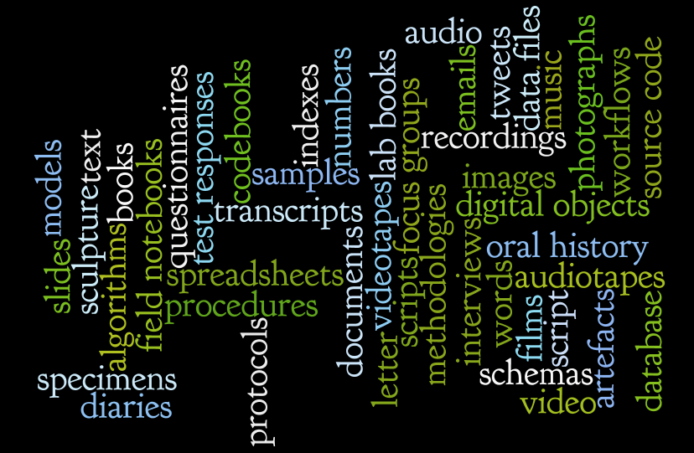
Research data: All of these, and more…

Slide 6
Activity: your research data
What types of research data do you use?

Slide 7
Introducing lifecycle models

Slide 8
The life of data
A dataset has a longer lifespan than the research project that created it
Data can be used and re-used if it is:
  Made available, well managed, preserved

Slide 9
UK Data Archive data lifecycle
Creating Data
Processing Data
Analysing Data
Preserving Data
Giving access to Data
Re-using Data

Slide 10
DCC data activity lifecycle
Create
Document
Use
Share
Preserve
Store

Slide 11
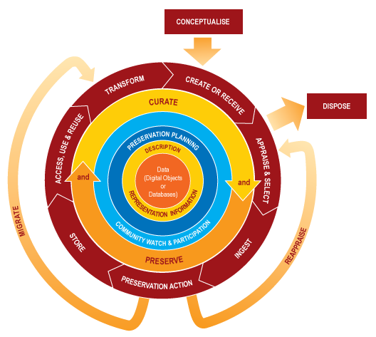
DCC Curation lifecycle model

Slide 12
Activity: Examining the DCC Curation lifecycle model
Are you a researcher, curator, or both?!

Slide 13
DCC Curation lifecycle model: actions
Full lifecycle actions
Sequential actions
Occasional actions

Slide 14
Take a closer look…
Examine the DCC Curation lifecycle model on the handout provided
  How relevant is it for your research?
    Assign a score 1-10
    (1 = not at all relevant, 10 = extremely relevant)

Slide 15
Session review

Slide 16
In summary
Take a holistic view of research data
Take a step back and consider research/data lifecycles
  How may cycles will your data go through?!

Slide 17
Acknowledgements
Digital Curation Centre (DCC)
  http://www.dcc.ac.uk/
The UK Data Archive
  http://www.data-archive.ac.uk/create-manage
DaMaRO RDM Training Materials, University of Oxford
  http://damaro.oucs.ox.ac.uk/training_materials.xml
Research data MANTRA [online course], EDINA and Data Library, University of Edinburgh
  http://datalib.edina.ac.uk/mantra/

